Slide 1
The Smartphone Project
Building a Smartphone From Scratch

Slide 2
Short and Concise SMART Goals
Build a fully functional smartphone
Prove that learning to build a smartphone from scratch doesn’t have to be a mystery
S
M
A
R
T

Slide 3
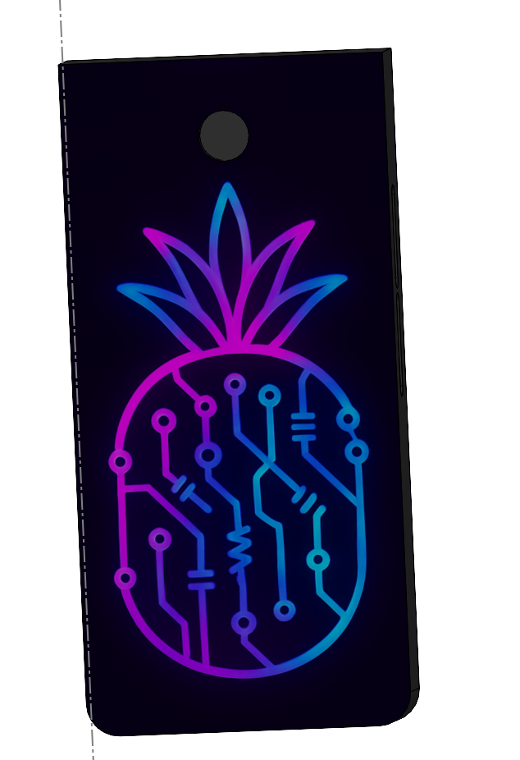
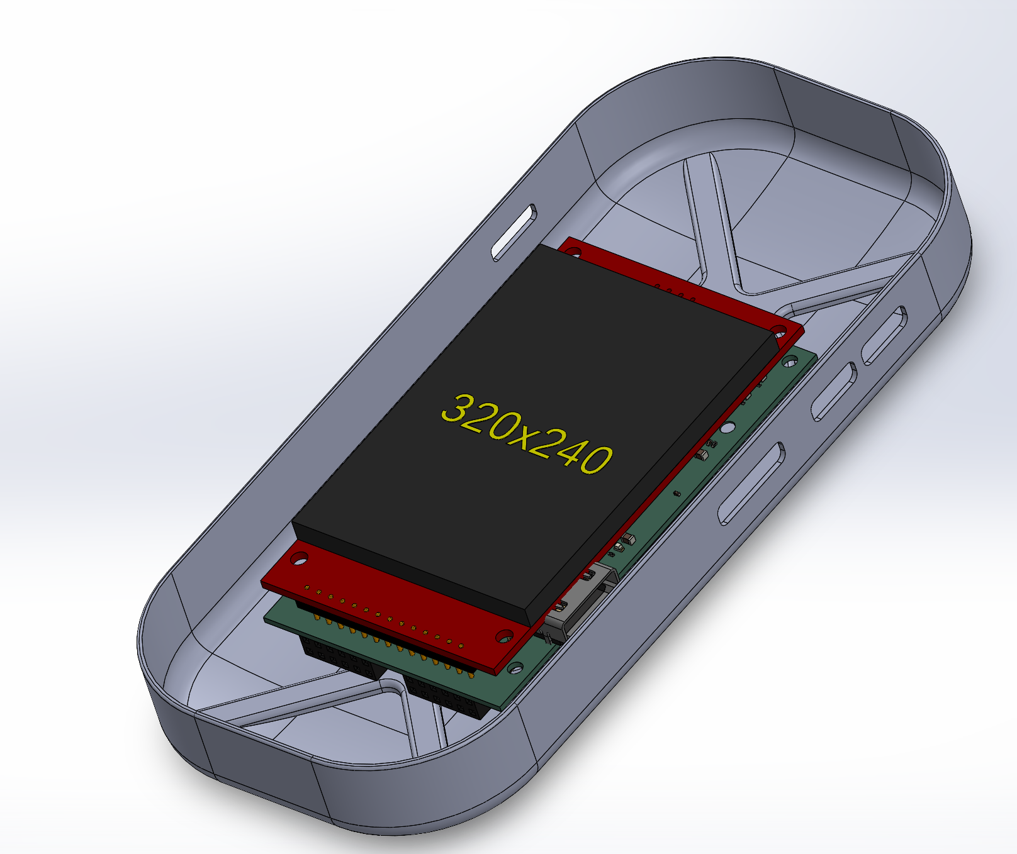
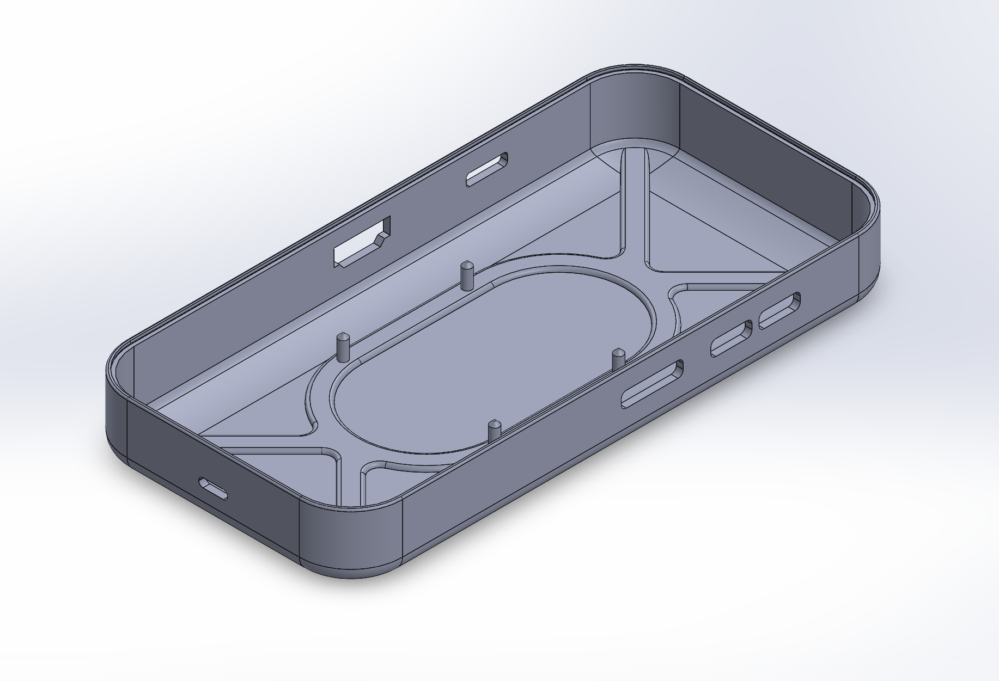
Disclaimer
Thermals & Enclosure Teams
We have multiple teams working on different aspects of the phone
  For the sake of simplicity, we will keep this presentation for the…
Notes:
Programmable Hardware enables
Ability for the AVERAGE PERSON to easily repair of various elements in a PRODUCT WE OWN
Ability to easily assemble/disassemble ALLOWS you to upgrade your perfectly good phone by replacing only the components on the phone that YOU want improved on your phone
Ability to make a modular phone, which would allow
YOU to make your phone distinctly YOURS (not an identical slab to everyone else)
YOU to decide what are important features to you and

Slide 4
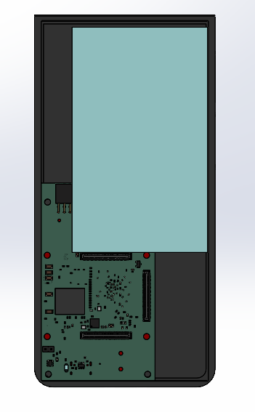
Design Constraints
Thermal Consideration
Enough Heat Needs To Be Dissipated To Prevent Thermal Throttling
Not Enough Space For Active Cooling
Air Gaps Impede Heat Dissipation
Not Burning Users Hands (40 - 45°C)
Enclosure Considerations
Ergonomics & Gripability
Must Protect Internal Electronics (& Battery(s))
Phone Exterior Size Constraints
Aspect Ratio of the Screen
Internal Components Size Constraints
Weight Distribution
Protection from the Elements (Water & Dust)

Slide 5
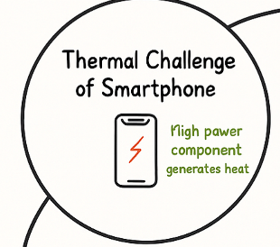
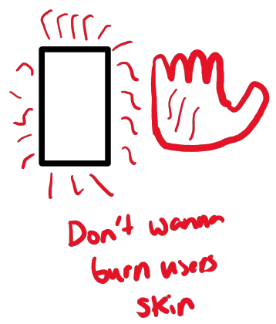
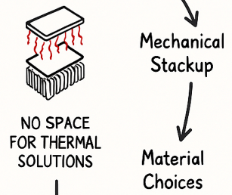
Approach To Addressing Design Constraints
Thermal Consideration
Thermal Approach
Enough Heat Needs To Be Dissipated To Prevent Thermal Throttling
Not Enough Space For Active Cooling
Air Gaps Impede Heat Dissipation
Not Burning Users Hands (40 - 45°C)
Minimize Still Air, Maximize Thermal Conductivity
  → Flatten PCB Topography
  → Sandwich PCB Between Copper Plates
Route the Heat To Top Of Phone Away From Hands

Slide 6
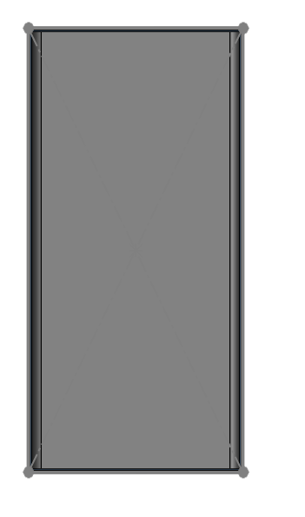
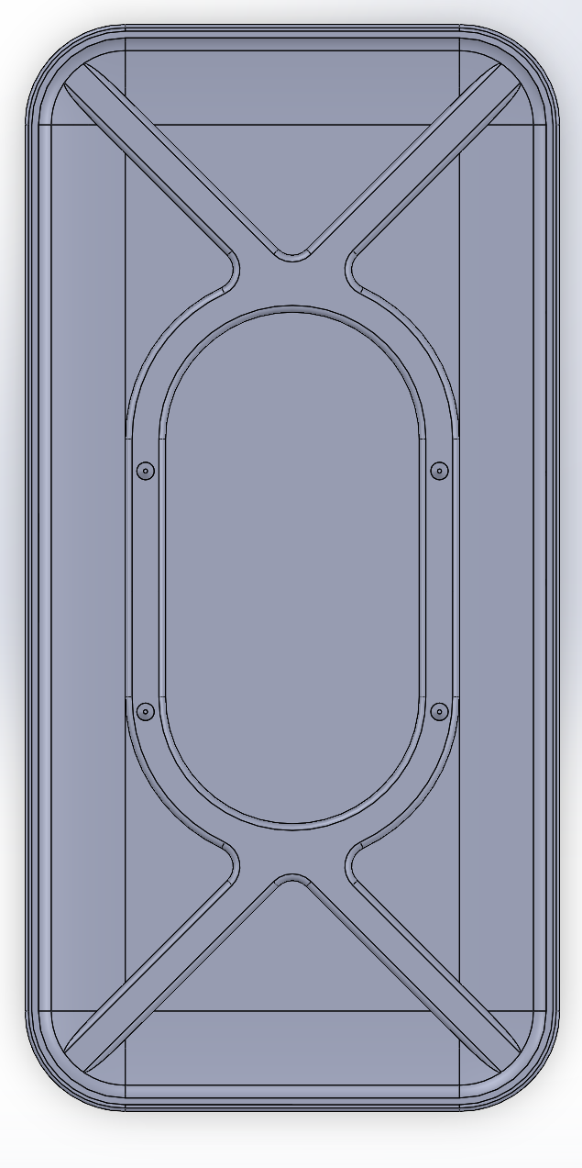

Quick Look Through The Versions
Version 1
Version 2
Version 3
Notes:
Haptic Motor Driver
Haptic Motor Driver is necessary to control haptic motor vibration patterns
Haptic Motor works by converting electrical energy into mechanical vibrations
Communicates through I²C peripherals
Real-Time Clock
Real-Time Clock counts time by counting the pulses of a stable quartz crystal oscillator
Uses a battery backup to maintain power independently of main power system in case of power off
Communicates through I²C peripherals
Microphone
Microphone captures sound waves (analog) and converts them into electrical signals
Multiple microphones are used to overall reduce noise caused by individual noise
Communicates through I²C peripherals

Slide 7

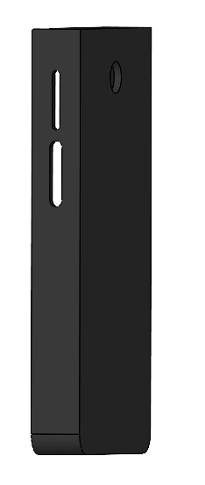
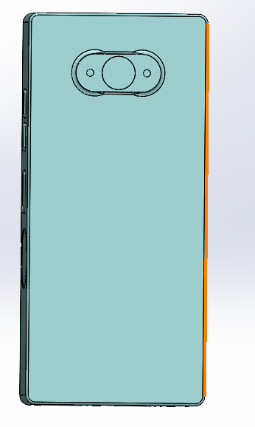
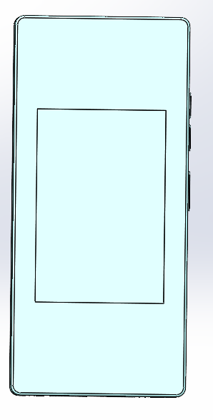
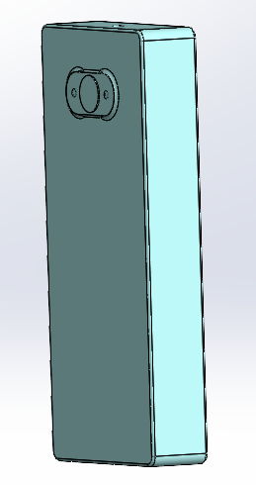
Version 1
Notes:
Programmable Hardware enables
Ability for the AVERAGE PERSON to easily repair of various elements in a PRODUCT WE OWN
Ability to easily assemble/disassemble ALLOWS you to upgrade your perfectly good phone by replacing only the components on the phone that YOU want improved on your phone
Ability to make a modular phone, which would allow
YOU to make your phone distinctly YOURS (not an identical slab to everyone else)
YOU to decide what are important features to you and

Slide 8
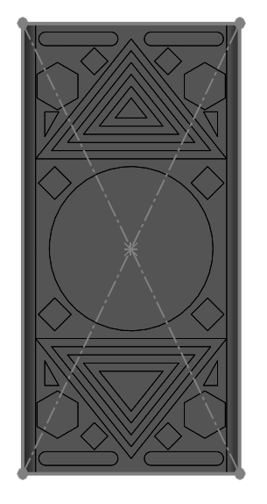
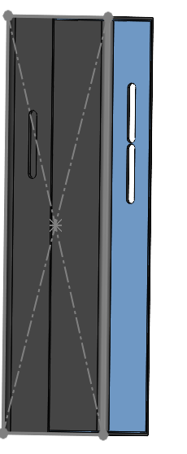
Version 2

Slide 9
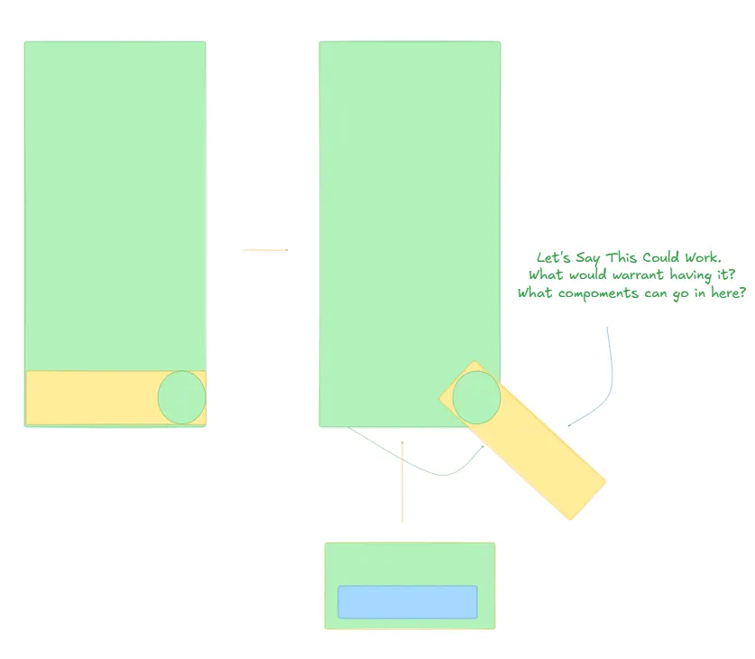
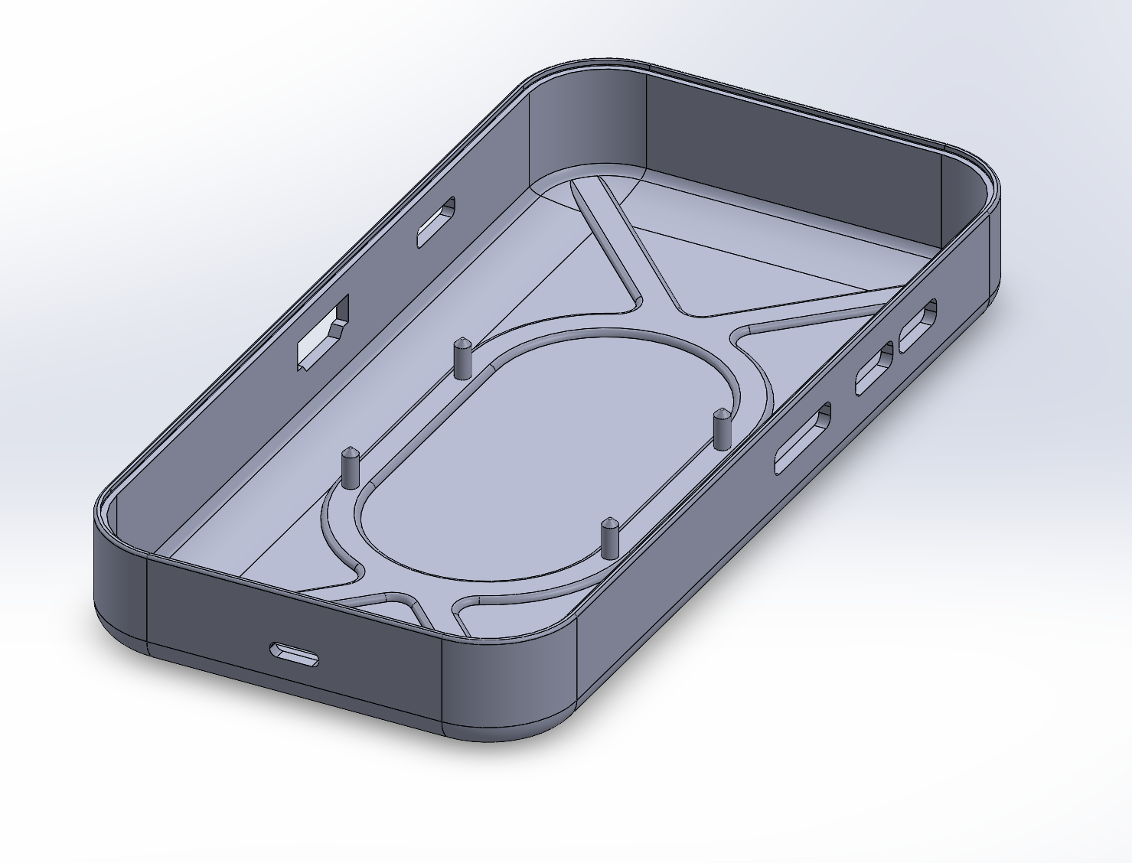
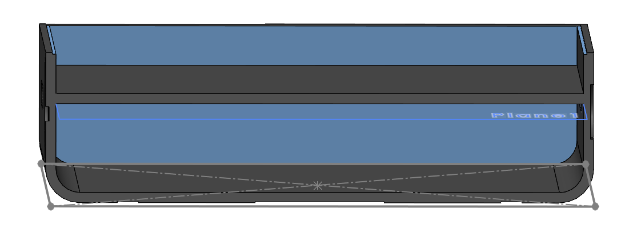
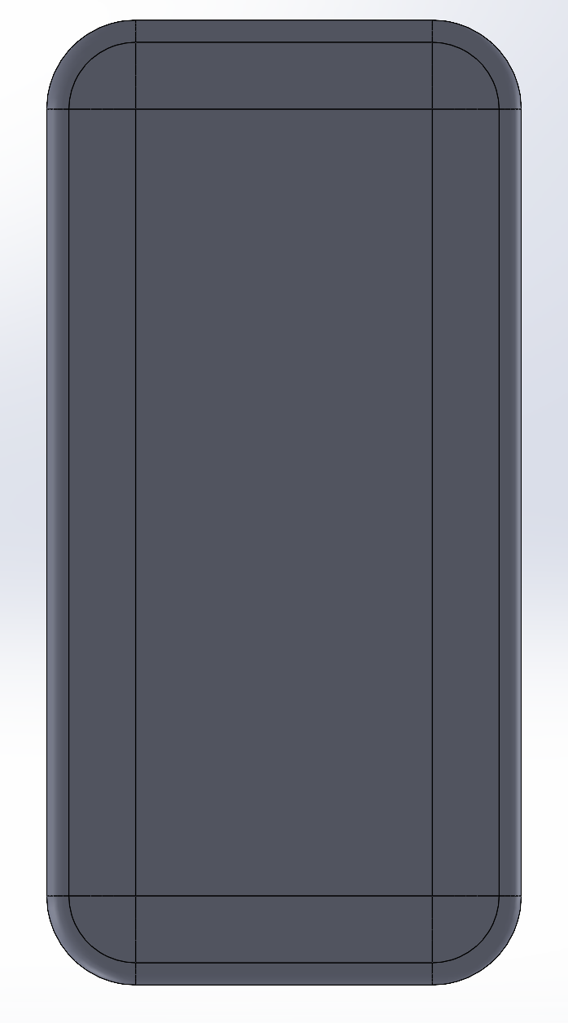
Version 3
Notes:
Project Definition
Consumer Need: Fast, secure, and user-friendly authentication → convenience and privacy
Feature: Allow users to unlock the device and verify their identity with a single touch
Purpose: Personal, Modern, and Secure
Determined the type of Fingerprint Sensor
Determined how the phone will communicate with these sensors
We then found the sensor, implemented the schematic, then converted that schematic to a 3D modeled version

Slide 10
Future Design Plans
Thermal Consideration
Enough Heat Needs To Be Dissipated To Prevent Thermal Throttling
Not Enough Space For Active Cooling
Air Gaps Impede Heat Dissipation
Not Burning Users Hands (40 - 45°C)
Enclosure Considerations
Ergonomics & Gripability
  → Exploring A Sliding Mechanism Design
Must Protect Internal Electronics (& Battery(s))
  → Exploring An Infill With Trusses on Edges
  → Drawing Fractures AWAY From Corner Critical Points

Slide 11
Thank You

